Slide 1
IoT Project
- Intranet of Titans

Slide 2

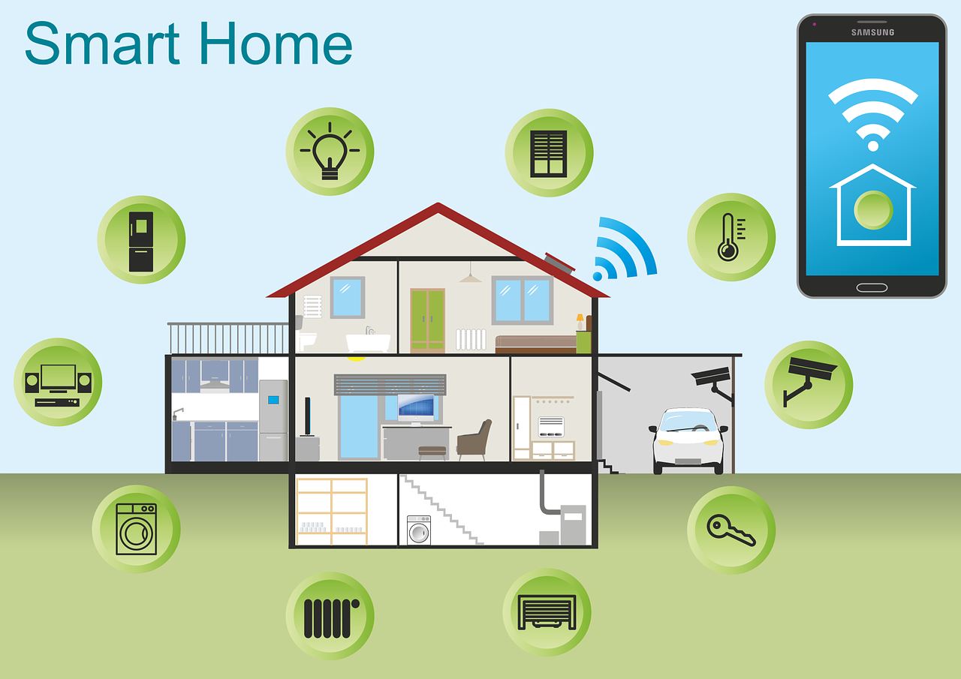
Smart Home
By Intranet of Titans

Slide 3
About Intranet of Titans:
Team Members:
Penumalla Aditya Pavani (2021101133)
Kadali Lakshmi Nirmala (2021101126)
Abhinay Maurya (2021101132)
Vempati Siva Koti Reddy (2021101135)

Slide 4
About Smart Home:
Our project involves
- Controlling electrical appliances using website
- Detecting arrival of vehicles and automatically opening the gate
- Monitoring Temperature and Humidity inside the home
- Detecting water level and giving alarm through buzzer

Slide 5
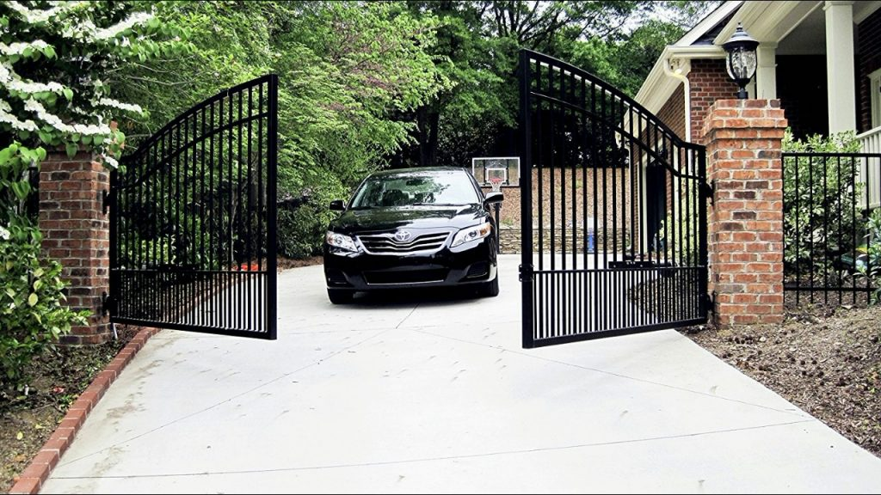
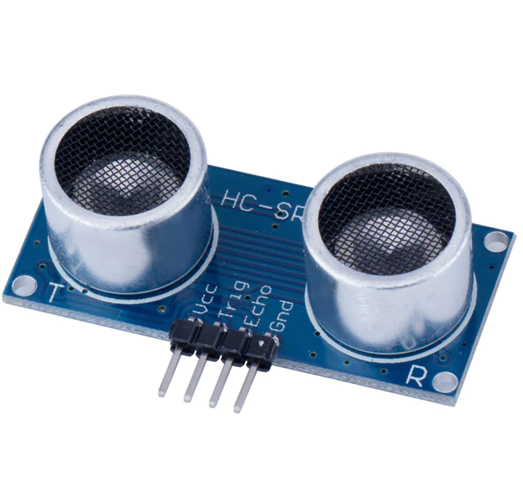
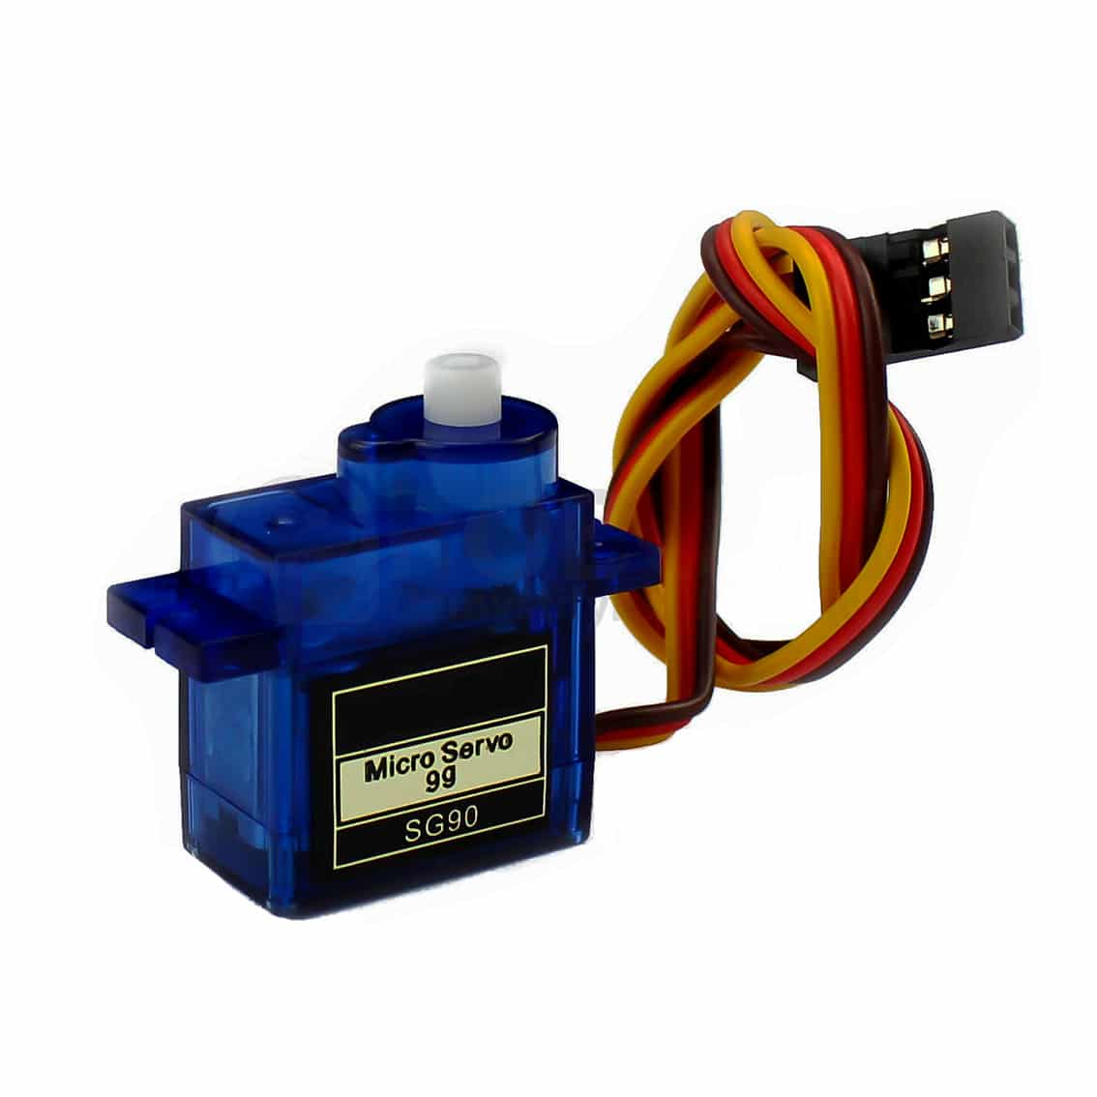
Gate Automation:
Ultrasonic sensor detects the motion of any vehicle which comes nearer to the Main gate.
After detecting the vehicle, the gate opens automatically by using Servo Motor.
This way it allows the vehicle inside.
Components used:
Ultrasonic Sensor
Servo Motor
Ultrasonic Sensor
Servo Motor

Slide 6
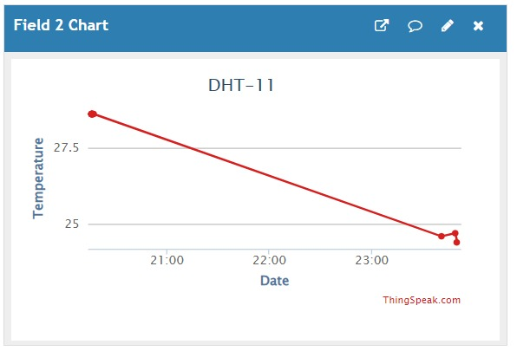
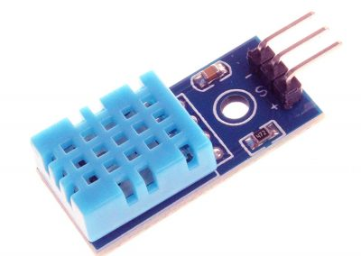
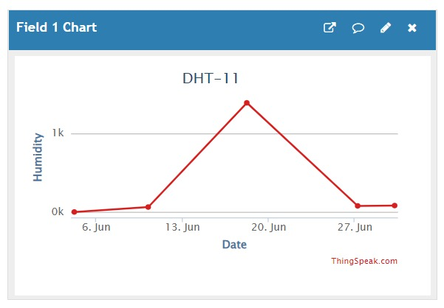
Monitoring Temperature
Here we are monitoring the temperature in the home daily and sending the data to ThingSpeak.
The Sensor we use is DHT11.
Beside is the Graph of the Temperature data sent to ThingSpeak.
Monitoring Humidity
Here we are monitoring the Humidity inside the home daily and sending the data to ThingSpeak.
The Sensor we use is DHT11.
Beside is the Graph of the Humidity data sent to ThingSpeak.
DHT11 Sensor

Slide 7
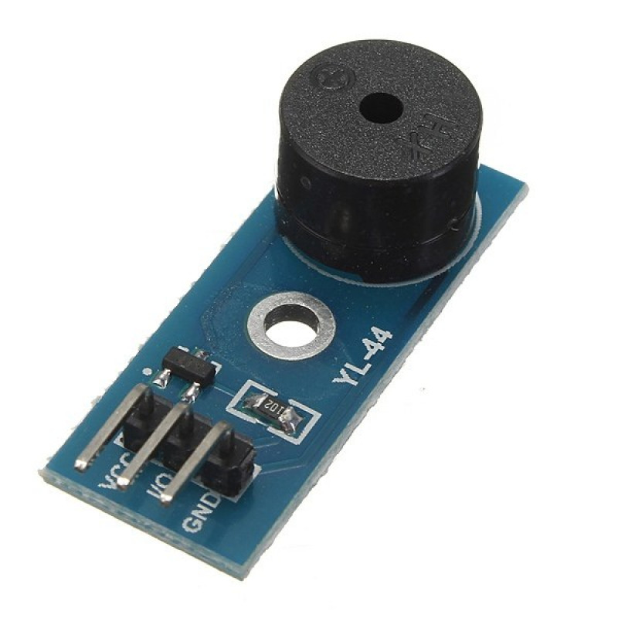
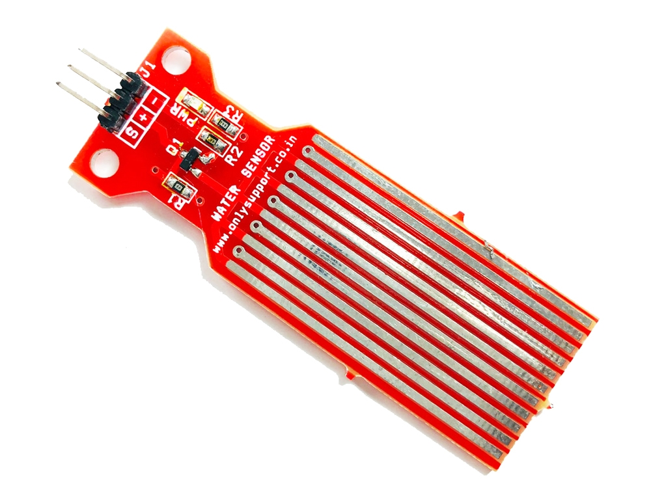
Water Level Indicator
Here we are monitoring the level of Water
The Sensor we are using is Water Level Sensor.
If the Water level in the tank is high, it will give alert through buzzer…it is also helpful in saving water.
Buzzer
Water Level Sensor

Slide 8
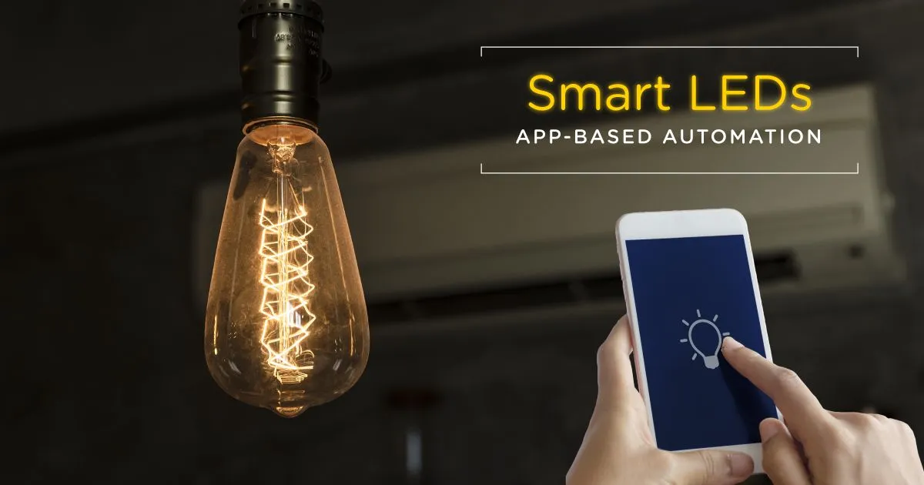
Controlling Electrical Appliances:
We are turning lights on and off in every room through website.
This way people could easily control electrical appliances from anywhere.
It helps to control our home just by using Website.

Slide 9
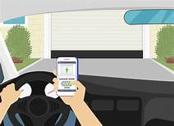

Smart Parking:
We made a smart parking slot where the shutter(door) of that slot is being controlled from website.
If you turn the button ON in the website, the shutter will open.
After parking the car, if you turn the button OFF in the website, the shutter will close.
Components we used to make this are Servo Motor & Jumper Wire.
This is to park the car safely.
Servo Motor

Slide 10
Advantages:
Home Automation improves the quality of life of the residents.
Due to Home Automation, the scope of human error is reduced and the system becomes more secure and robust.
Due to the application of website we have complete manual control on all the appliances and as a result, the residents have more flexibility in the ways they can use their devices.

Slide 11
THANK YOU

